Slide 1
Python
Data types and operators
Control flow
Functions
scripting

Slide 2
01. Intro

Slide 3
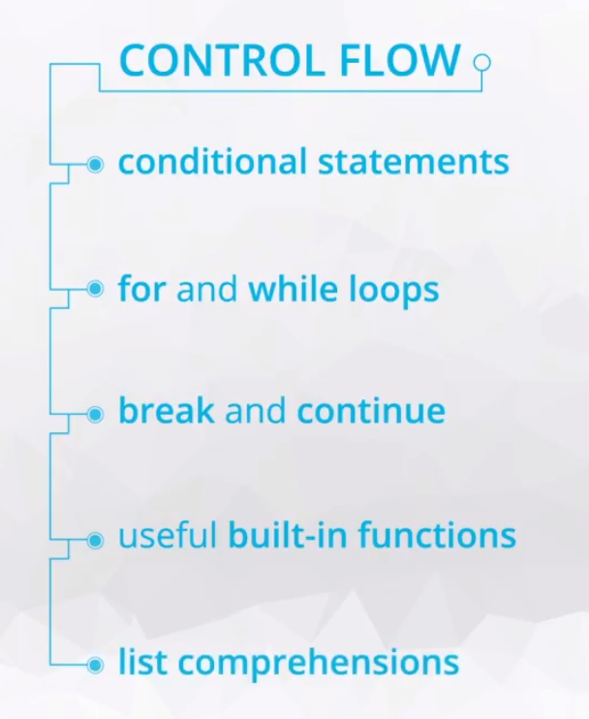

Slide 4
02. Conditional Statements

Slide 5


Slide 6
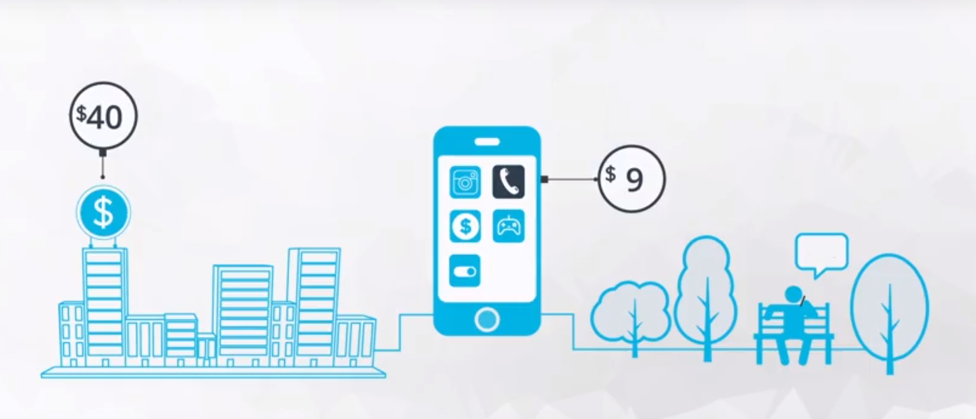

Slide 7
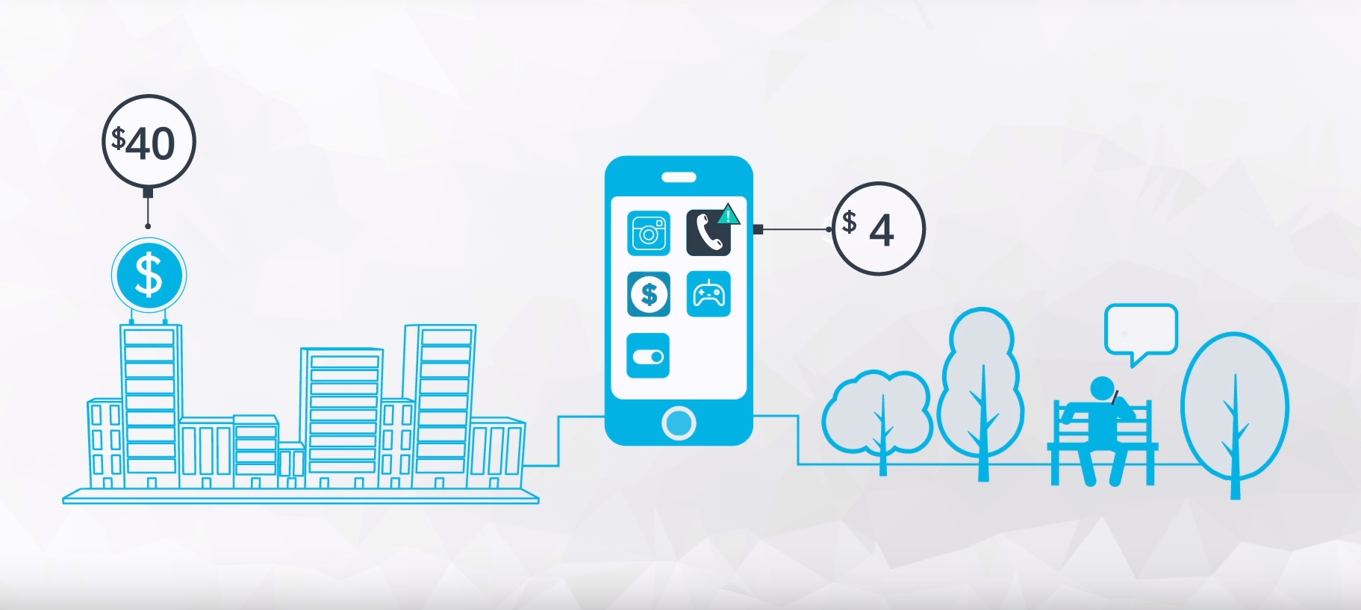

Slide 8
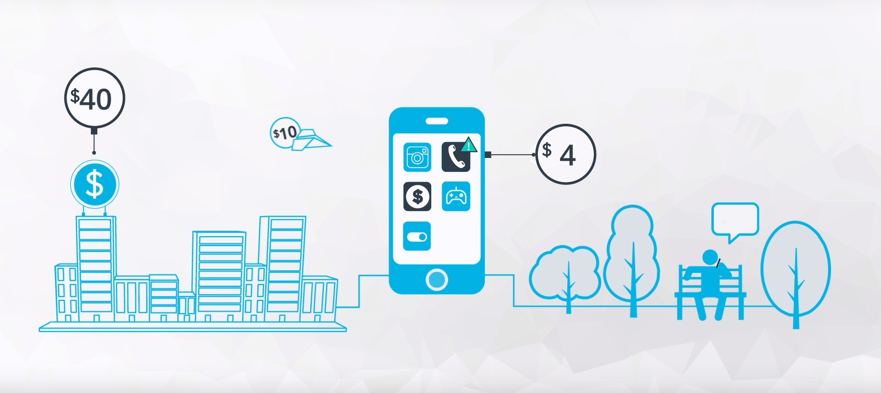

Slide 9
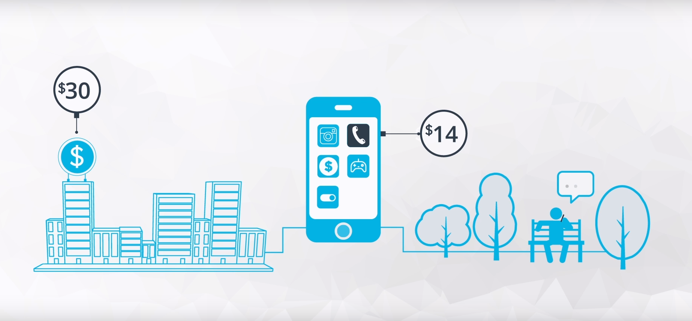

Slide 10
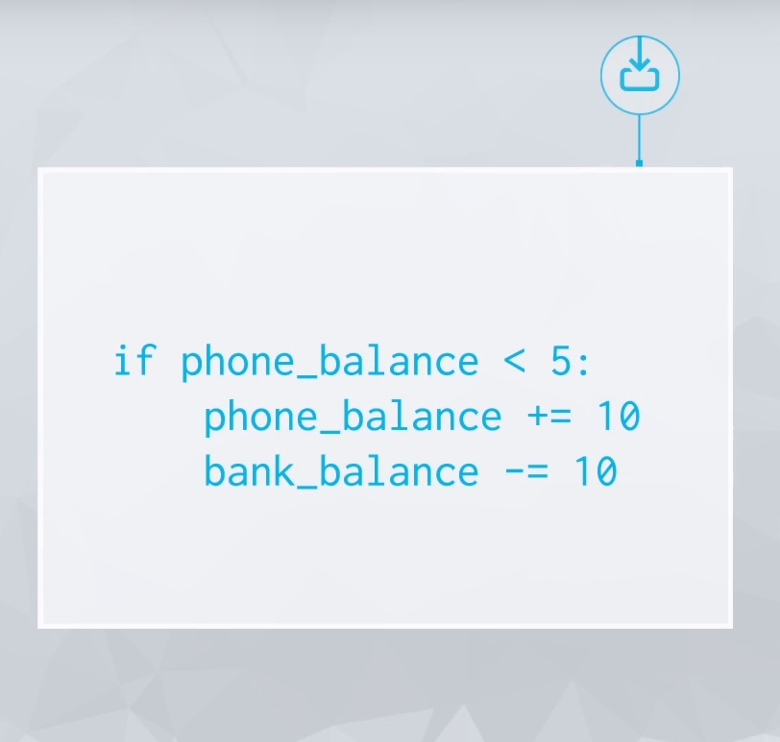

Slide 11
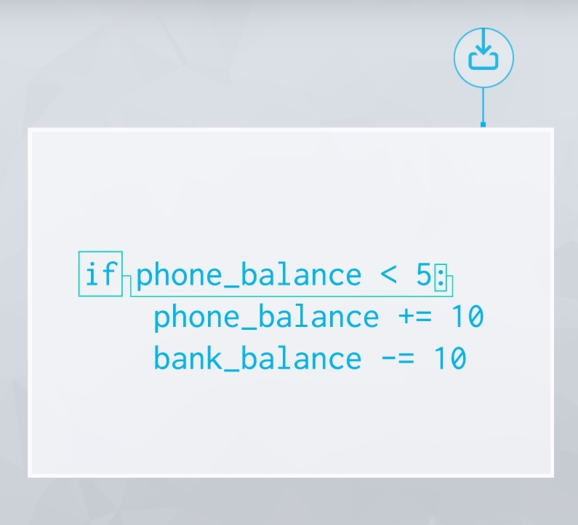

Slide 12
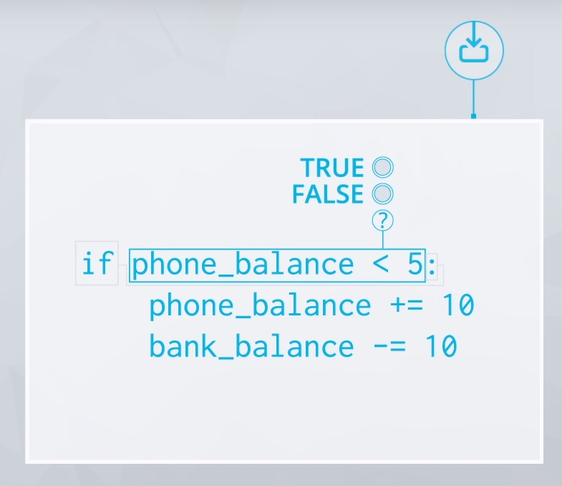

Slide 13
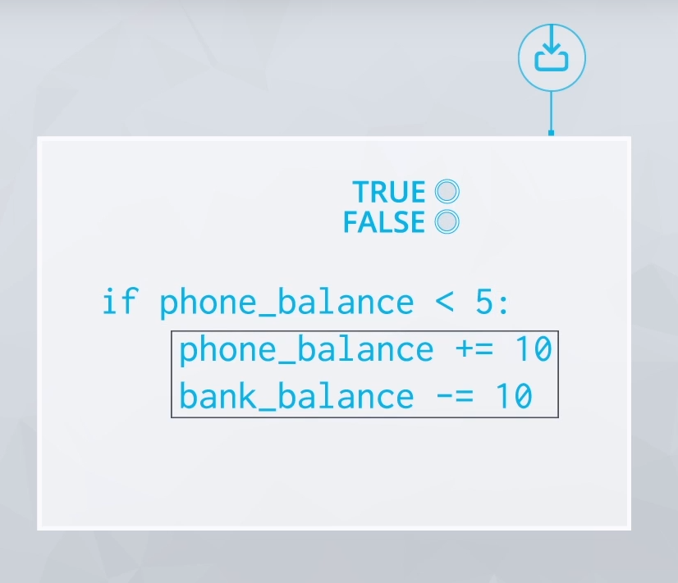

Slide 14
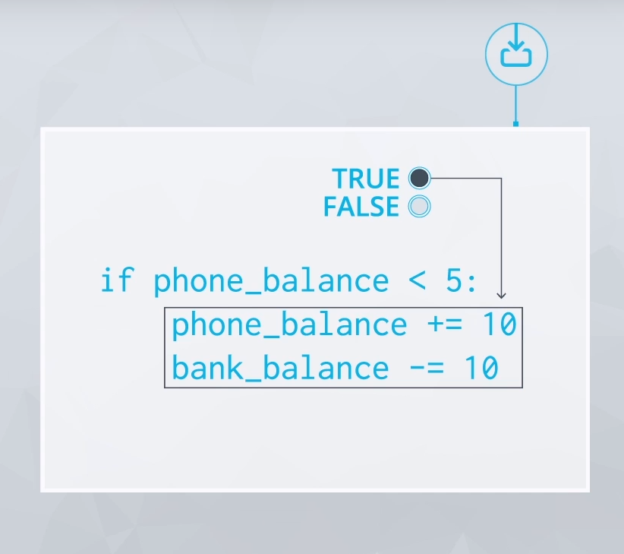

Slide 15
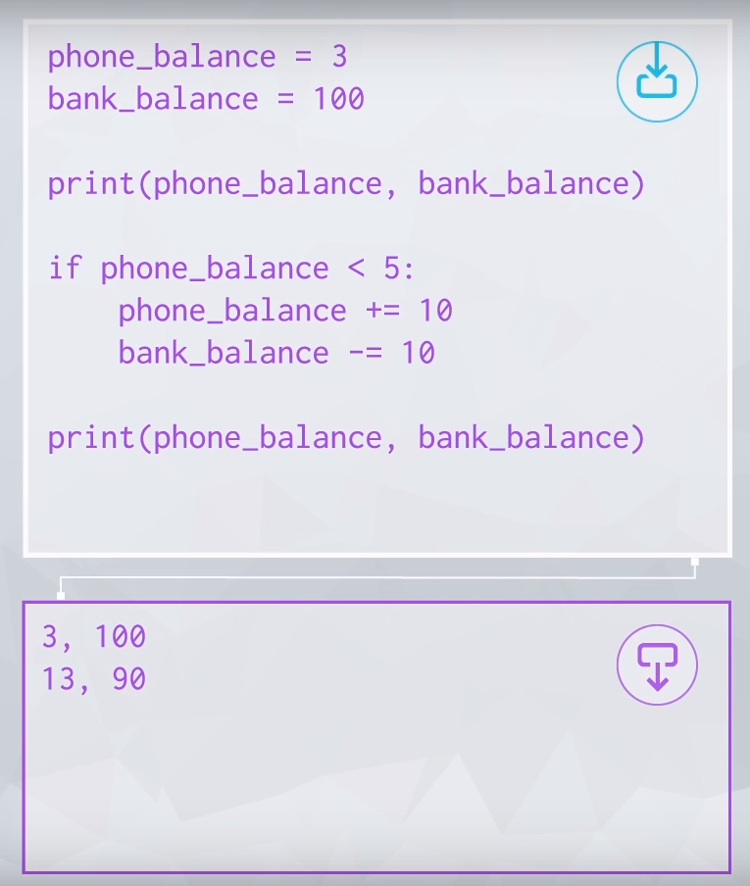

Slide 16
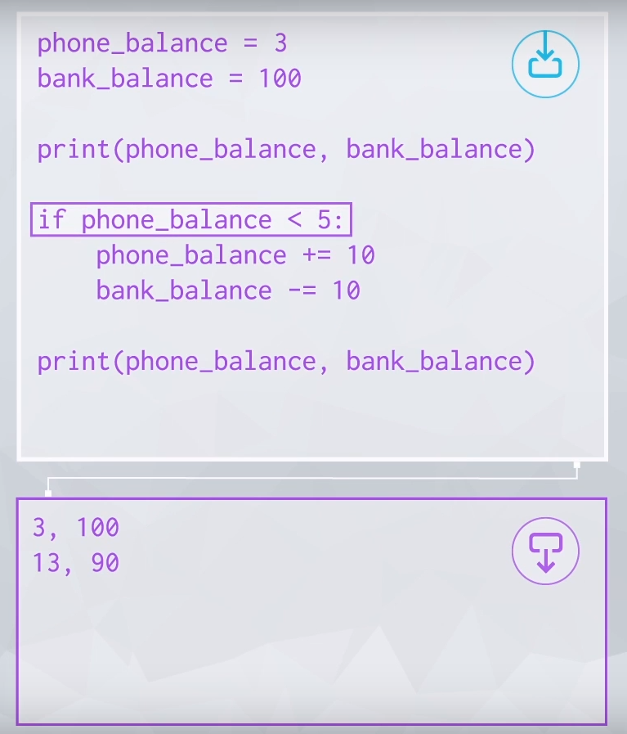

Slide 17
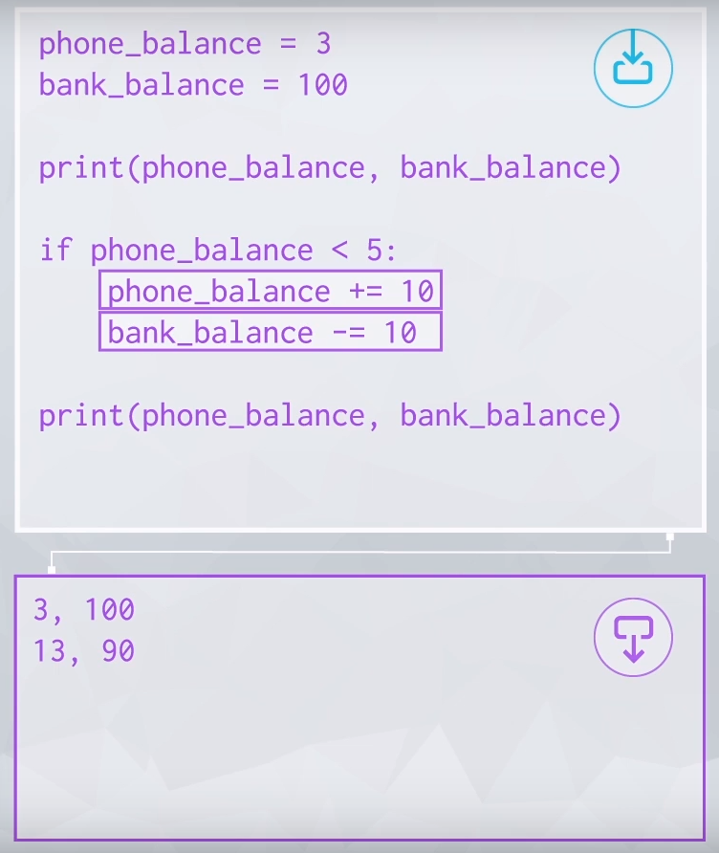

Slide 18
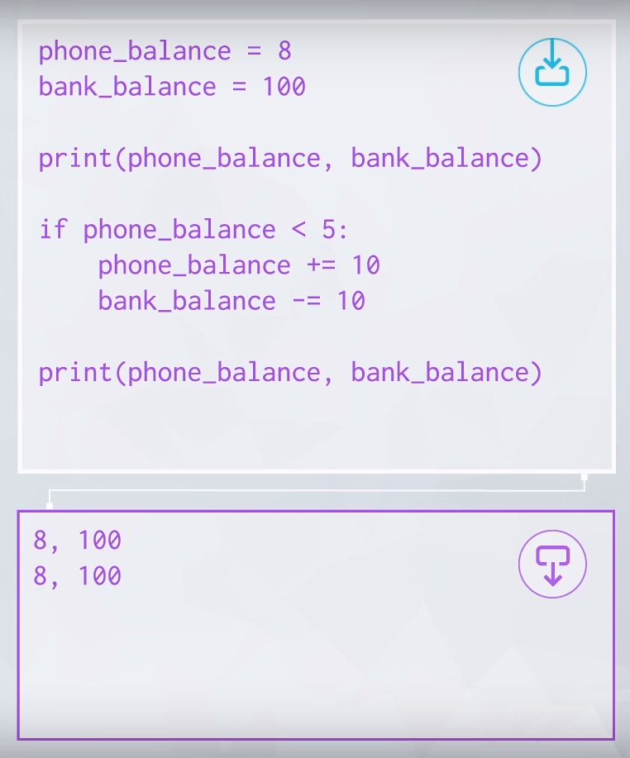

Slide 19
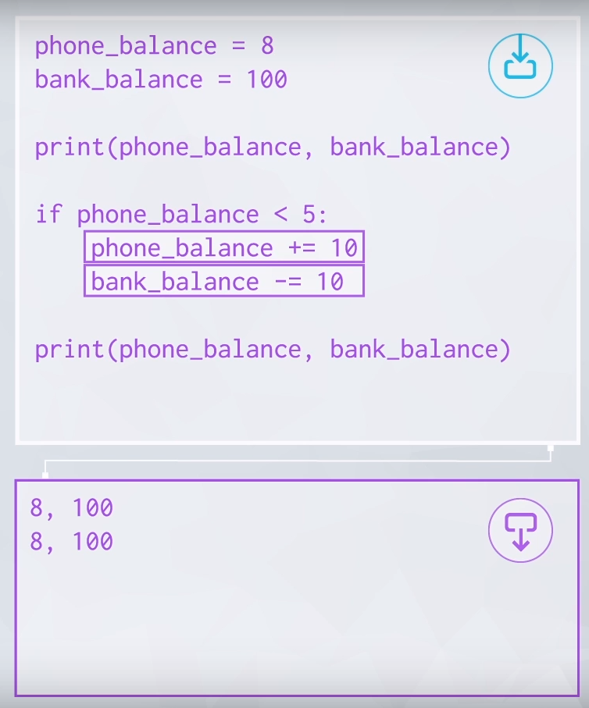

Slide 20
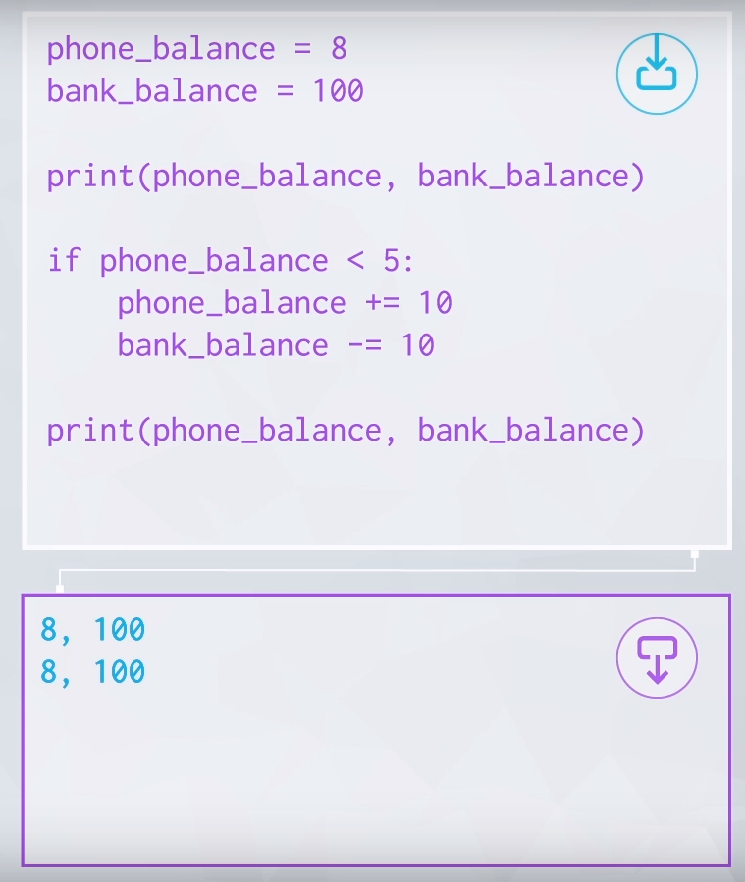

Slide 21
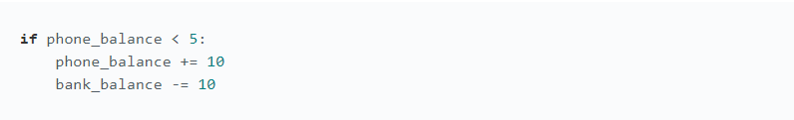
If Statement
An if statement is a conditional statement that runs or skips code based on whether a condition is true or false. Here's a simple example.
An if statement starts with the if keyword, followed by the condition to be checked, in this case phone_balance < 5, and then a colon. The condition is specified in a boolean expression that evaluates to either True or False.
After this line is an indented block of code to be executed if that condition is true. Here, the lines that increment phone_balance and decrement bank_balance only execute if it is true that phone_balance is less than 5. If not, the code in this if block is simply skipped.

Slide 22
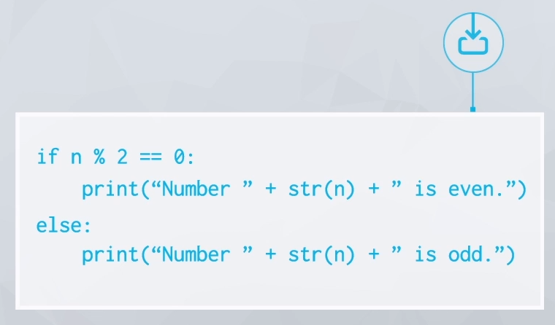

Slide 23
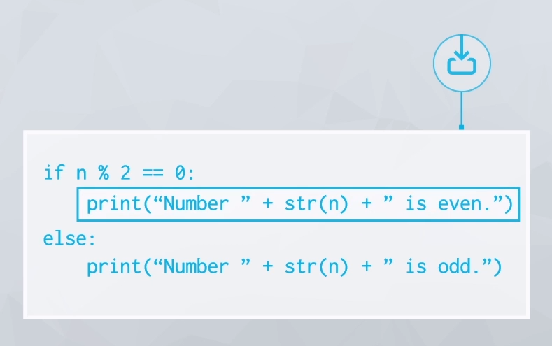

Slide 24
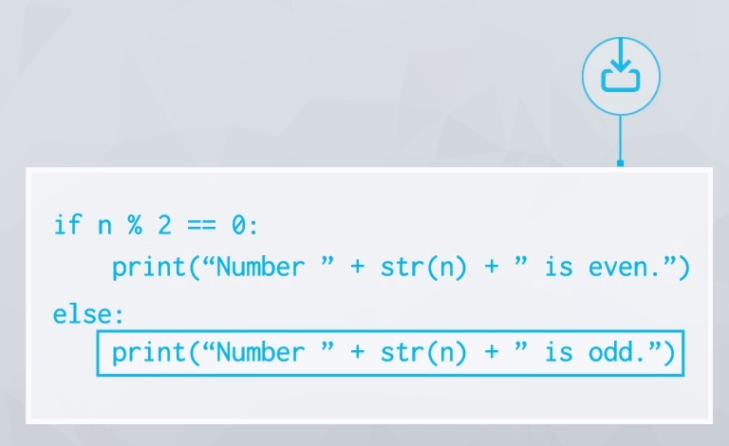

Slide 25
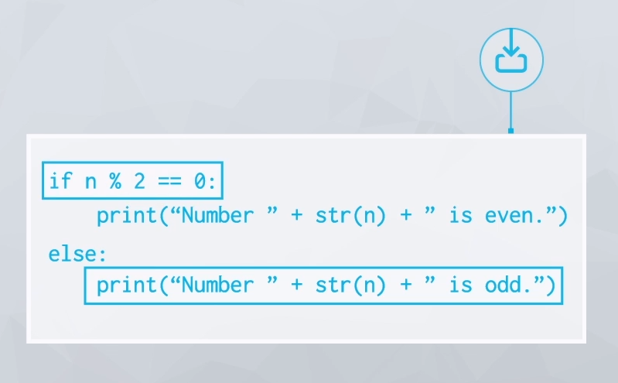

Slide 26
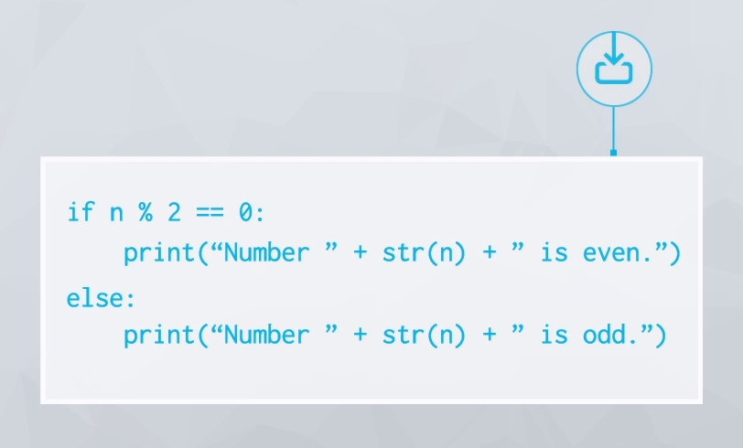

Slide 27
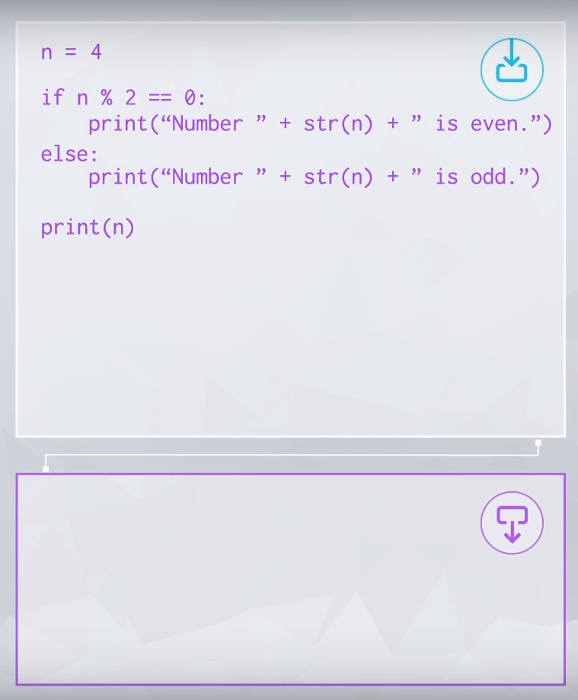

Slide 28
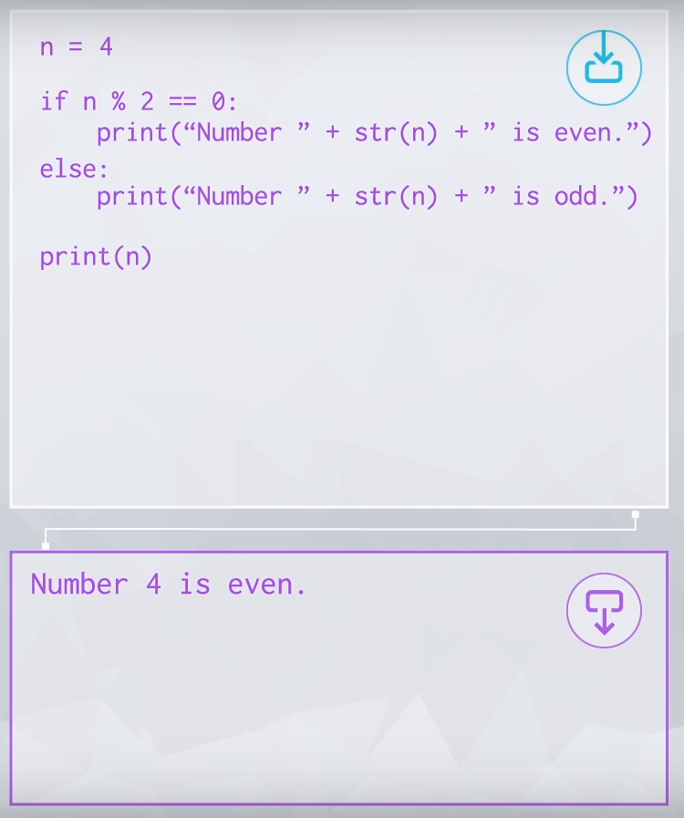

Slide 29


Slide 30
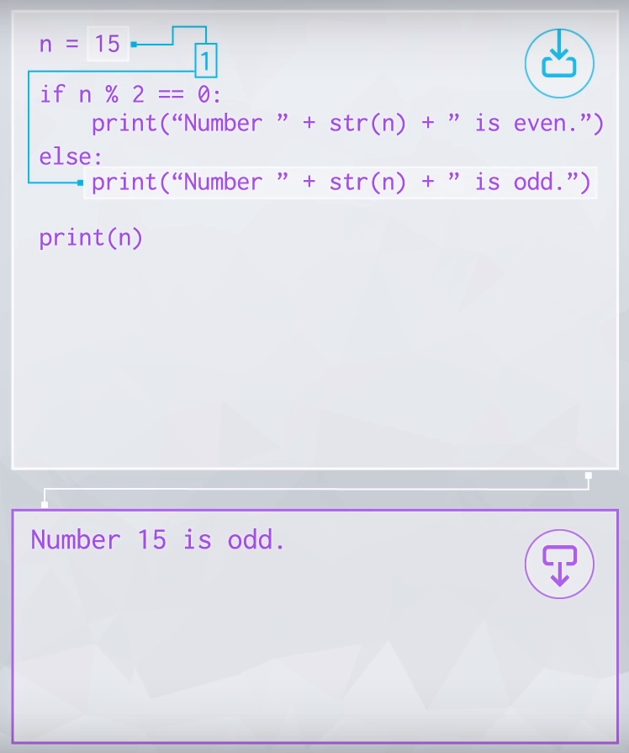

Slide 31
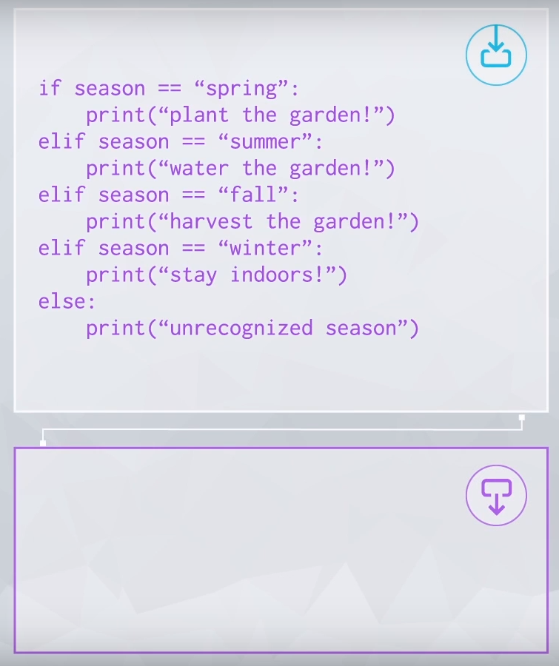

Slide 32
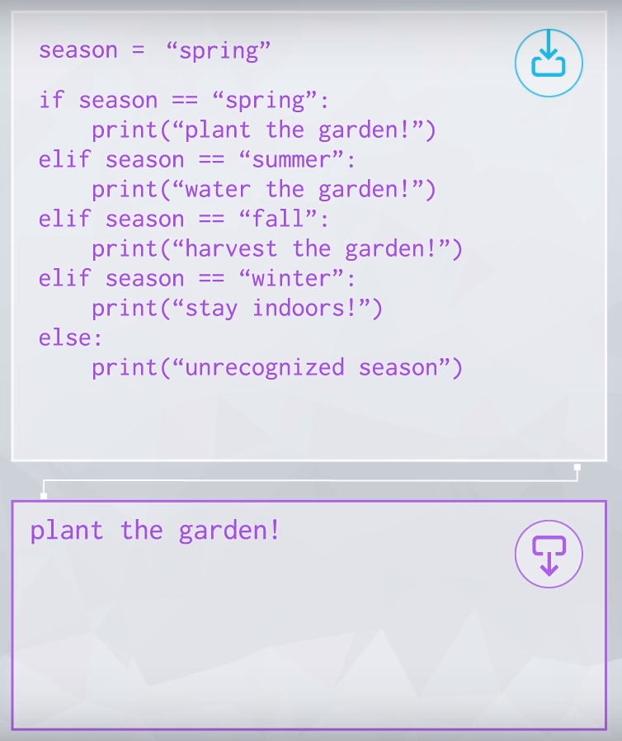

Slide 33
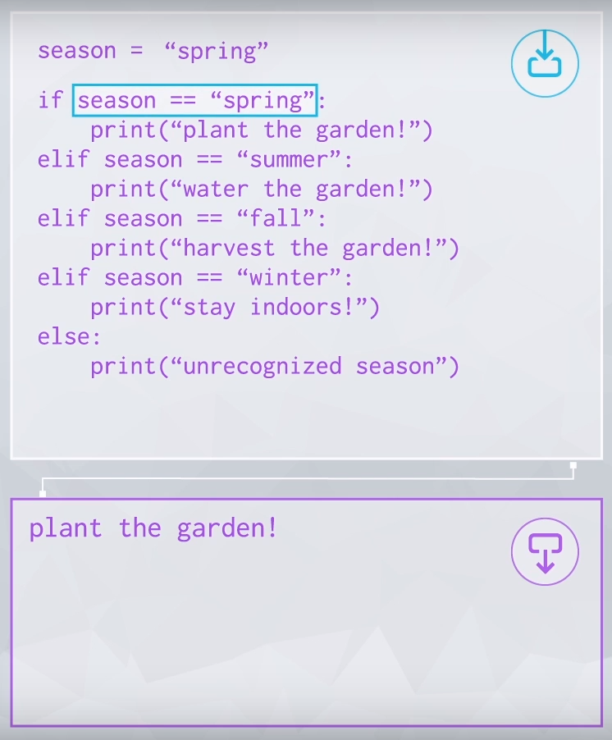

Slide 34
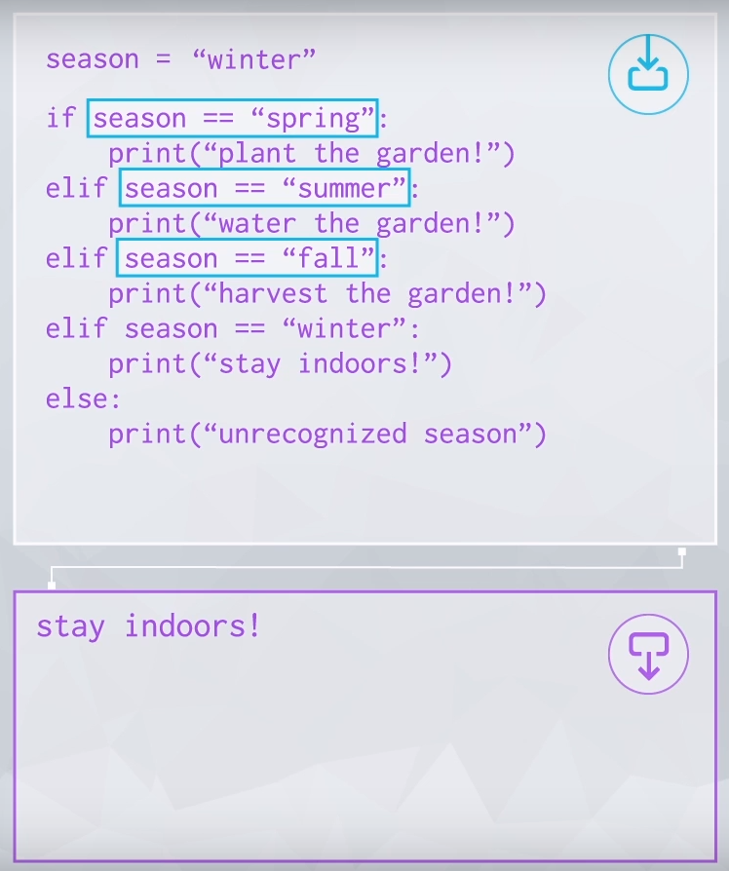

Slide 35
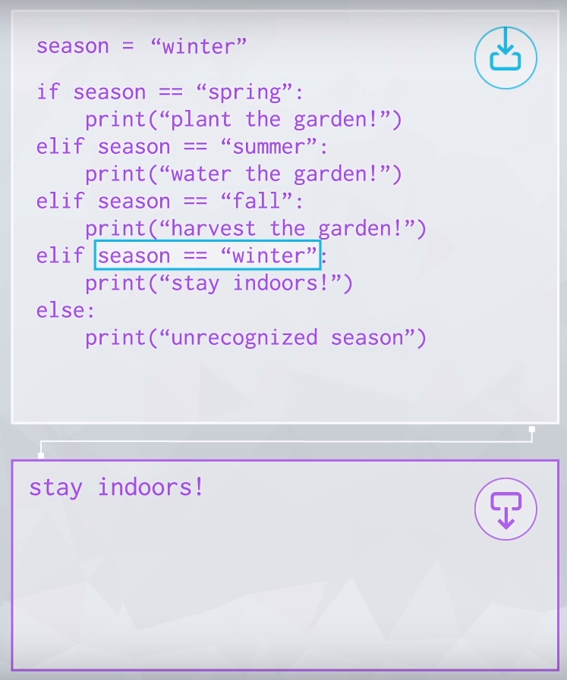

Slide 36
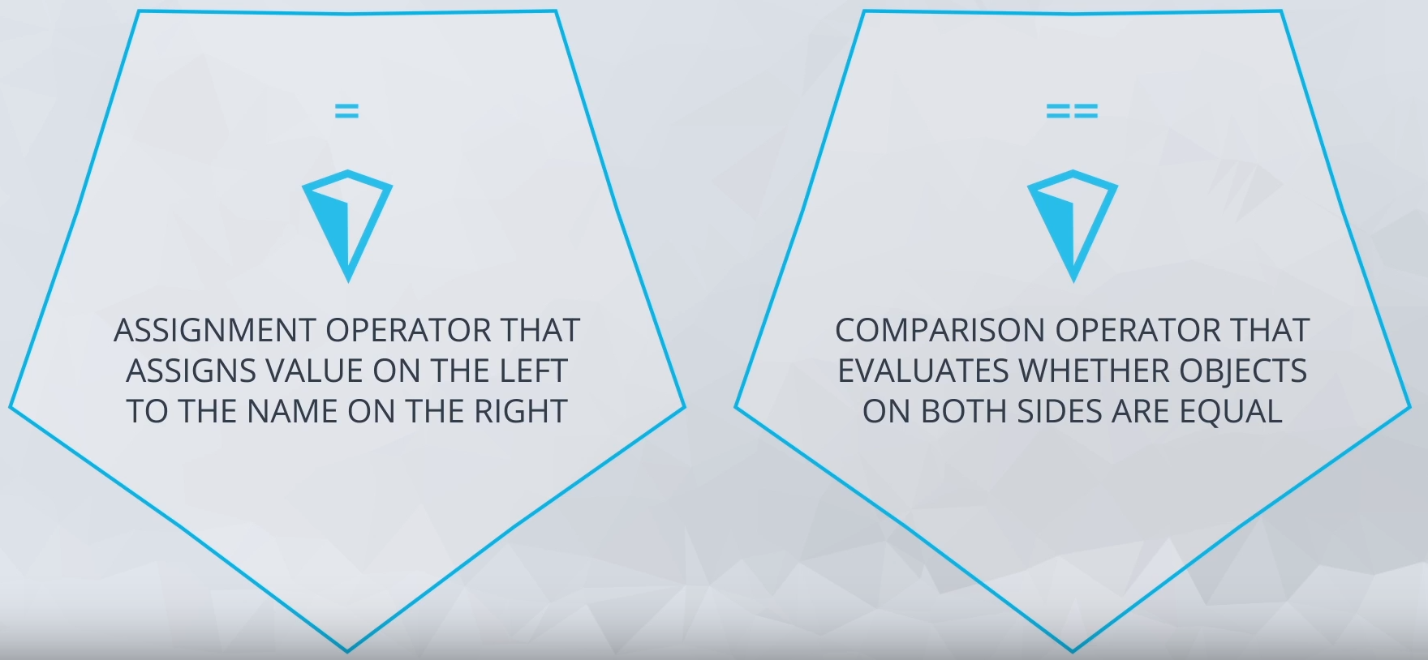

Slide 37
If, Elif, Else
In addition to the if clause, there are two other optional clauses often used with an if statement. Example:

Slide 38
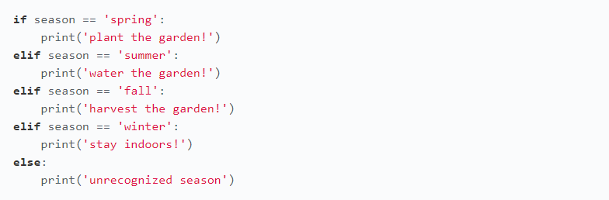
if: An if statement must always start with an if clause, which contains the first condition that is checked. If this evaluates to True, Python runs the code indented in this if block and then skips to the rest of the code after the if statement.
elif: An elif clause is used to check for an additional condition if the conditions in the previous clauses in the if statement evaluate to False. As you can see in the example, you can have multiple elif blocks to handle different situations.
else: Last is the else clause, which must come at the end of an if statement if used. This clause doesn't require a condition. The code in an else block is run if all conditions above that in the if statement evaluate to False.

Slide 39
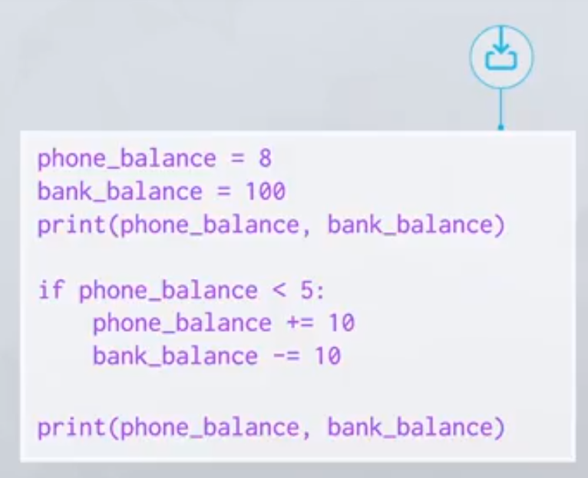

Slide 40
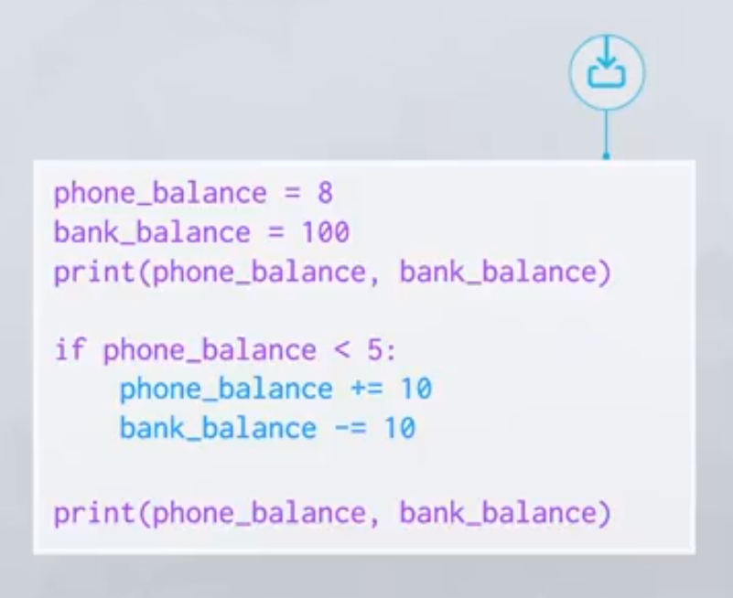

Slide 41
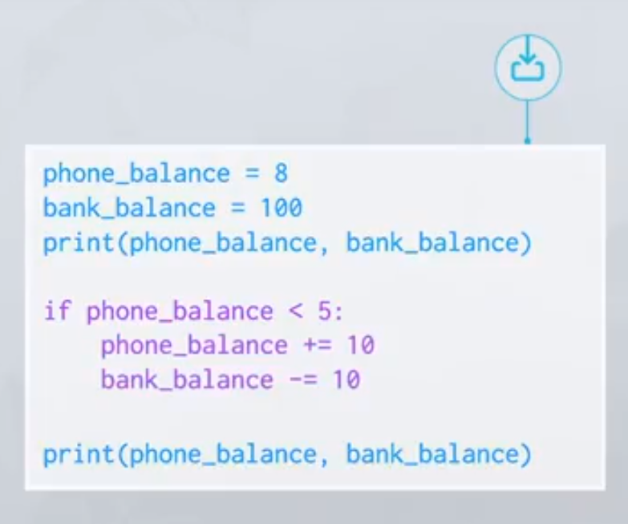

Slide 42
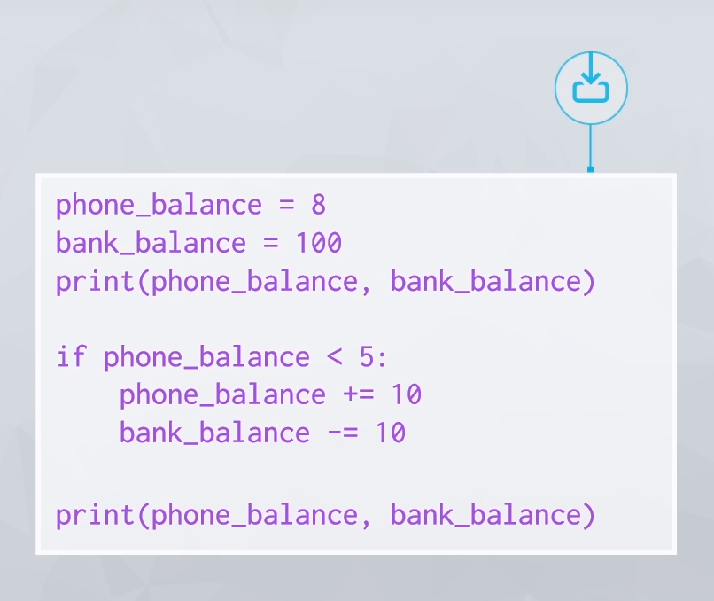

Slide 43
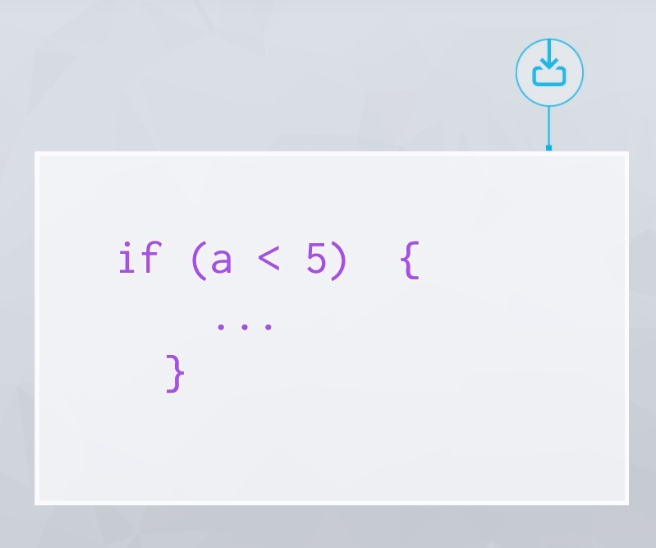

Slide 44
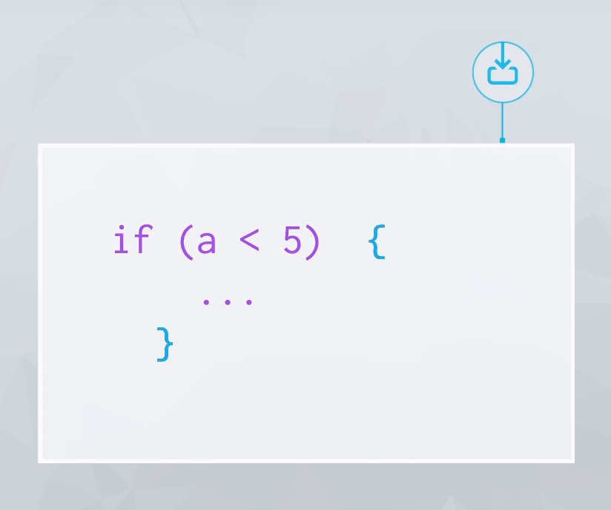

Slide 45
Indentation
Some other languages use braces to show where blocks of code begin and end. In Python we use indentation to enclose blocks of code. For example, if statements use indentation to tell Python what code is inside and outside of different clauses.
In Python, indents conventionally come in multiples of four spaces. Be strict about following this convention, because changing the indentation can completely change the meaning of the code. If you are working on a team of Python programmers, it's important that everyone follows the same indentation convention!

Slide 46
03. Conditional Statements Quiz

Slide 47
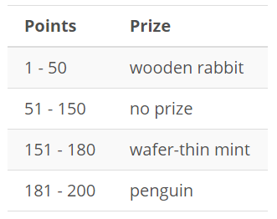
QUESTION 1
Write an if statement that lets a competitor know which of these prizes they won based on the number of points they scored, which is stored in the integer variable points.
All of the lower and upper bounds here are inclusive, and points can only take on positive integer values up to 200.
In your if statement, assign the result variable to a string holding the appropriate message based on the value of points. If they’ve won a prize, the message should state “Congratulations! You won a [prize name]!” with the prize name. If there’s no prize, the message should state “Oh dear, no prize this time.”
When you submit your answer, only use the original input of points = 174.

Slide 48
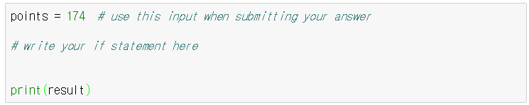

Slide 49
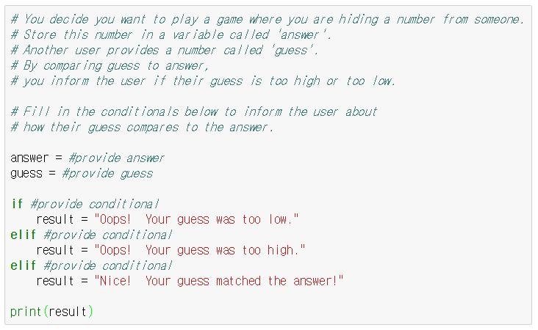
QUESTION 2
You decide you want to play a game where you are hiding a number from someone. Store this number in a variable called ‘answer’. Another user provides a number called ‘guess’. By comparing guess to answer, you inform the user if their guess is too high or too low.
Fill in the conditionals below to inform the user about how their guess compares to the answer.

Slide 50
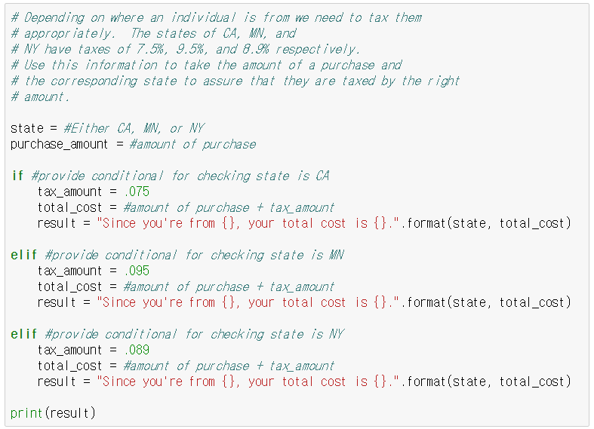
QUESTION 3
Depending on where an individual is from we need to tax them appropriately. The states of CA, MN, and NY have taxes of 7.5%, 9.5%, and 8.9% respectively. Use this information to take the amount of a purchase and the corresponding state to assure that they are taxed by the right amount.

Slide 51
04. Boolean Expressions for Conditions

Slide 52
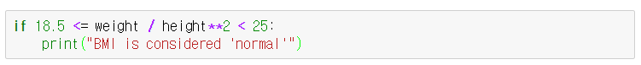

Slide 53
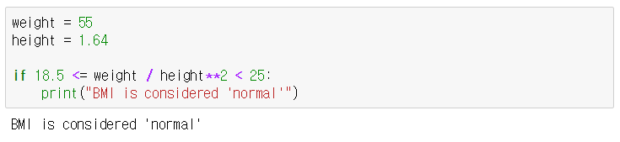

Slide 54
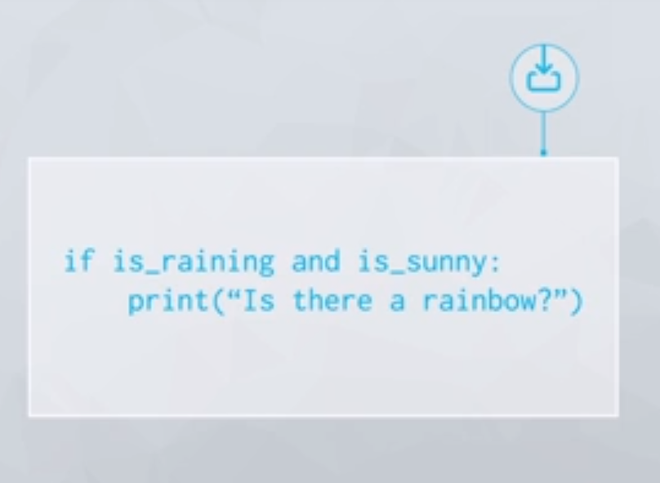

Slide 55
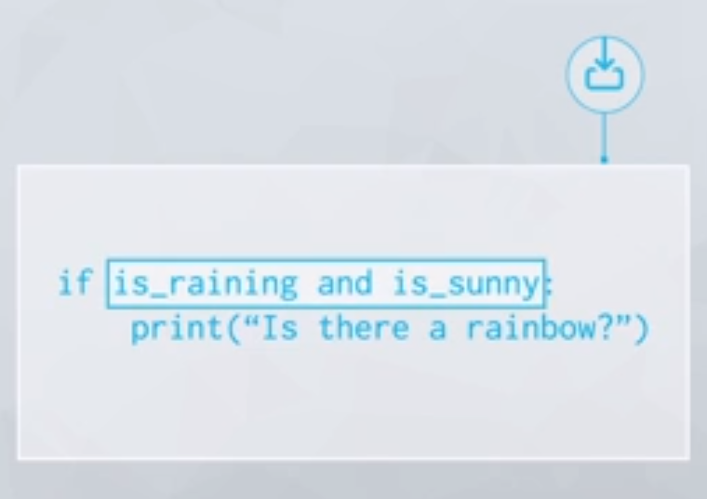

Slide 56
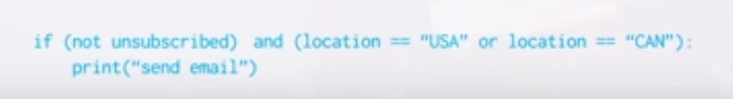

Slide 57
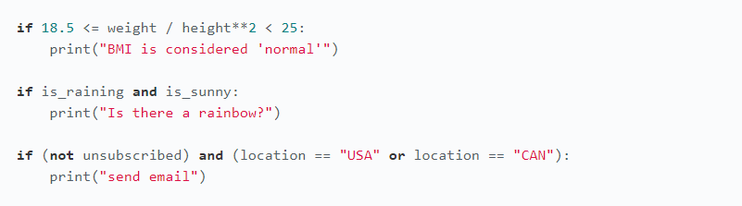
Complex Boolean Expressions
If statements sometimes use more complicated boolean expressions for their conditions. It may contain multiple comparisons operators, logical operators, and even calculations. Examples:
For really complicated conditions you might need to combine some ands, ors and nots together. Use parentheses if you need to make the combinations clear.
However simple or complex, the condition in an if statement must be a boolean expression that evaluates to either True or False and it is this value that decides whether the indented block in an if statement executes or not.

Slide 58
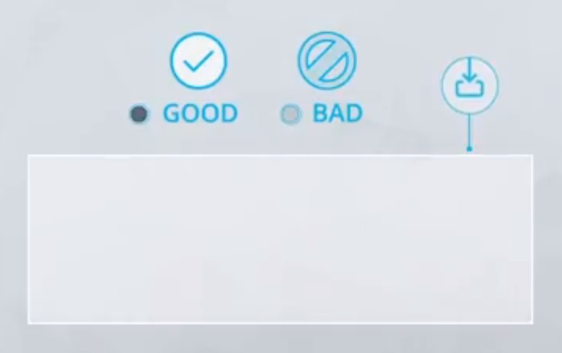

Slide 59
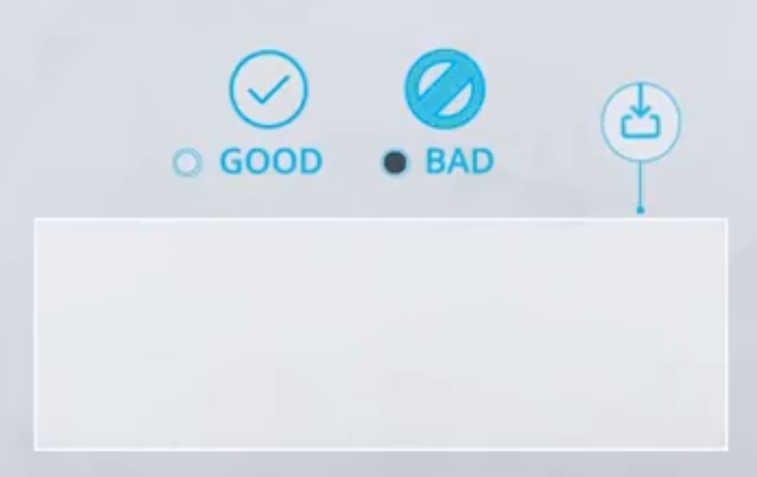

Slide 60


Slide 61


Slide 62


Slide 63


Slide 64


Slide 65


Slide 66


Slide 67


Slide 68


Slide 69


Slide 70


Slide 71


Slide 72


Slide 73


Slide 74


Good and Bad Examples
Here are some things to keep in mind while writing Boolean expressions for your if statements.
1. Don’t use True or False as conditions
While “True” is a valid Boolean expression, it’s not useful as a condition since it always evaluates to True, so the indented code will always get run. Similarly, if False is not a condition you should use either – the statement following this if statement would never executed.

Slide 75

Similarly, it’s useless to use any condition that you know will always evaluate to True, like this example above. A Boolean variable can only be True or False, so either is_cold or not is_cold is always True, and the indented code will always be run.
2. Be careful writing expressions that use logical operators
Logical operators and, or and not have specific meanings that aren’t quite the same as their meanings in plain English. Make sure your Boolean expressions are being evaluated the way you expect them to.
This code is valid in Python, but it is not a Boolean expression, although it reads like one. The reason is that the expression to the right of the or operator, “rain”, is not a Boolean expression – it’s a string!

Slide 76


3. Don’t compare a Boolean variable with == True or == False
This comparison isn’t necessary, since the Boolean variable itself is a Boolean expression.
This is a valid condition, but we can make the code more readable by using the variable itself as the condition instead, as below.
If you want to check whether a Boolean is False, you can use the not operator.

Slide 77


Slide 78


Slide 79


Slide 80


Slide 81


Slide 82


Slide 83


Slide 84
Truth Value Testing
If we use a non-Boolean object as a condition in an if statement in place of the Boolean expression, Python will check for its truth value and use that to decide whether or not to run the indented code. By default, the truth value of an object in Python is considered True unless specified as False in the documentation.
Here are most of the built-in objects that are considered False in Python:
- constants defines to be false: None and False
- zero of any numeric type: 0, 0.0, 0j, Decimal(0), Fraction(0, 1)
- empty sequences and collections: “”, (), [], {}, set(), range(0)

Slide 85

Example:
In this code, errors has the truth value True because it’s a non-zero number, so the error message is printed. This is nice, succinct way of writing an if statement.

Slide 86

05. Boolean Expressions for Conditions Quiz
QUESTION 1
Imagine an air traffic control program that tracks three variables, altitude, speed, and propulsion which for a particular airplane have the values specified below.
For each of the following Boolean expressions, work out whether it evaluates to True or False an match the correct value.

Slide 87

QUESTION 2.
The code below is the solution to the Which Prize quiz you’ve seen previously. You’re going to rewrite this based on what you’ve learned about truth values.
You will use a new variable prize to store a prize name if one was won, and then use the truth value of this variable to compose the result message. This will involve two if statements.

Slide 88

1st conditional statement: update prize to the correct prize name based on points.
2nd conditional statement: set result to the correct phrase based on whether prize is evaluated as True or False.
- If prize is None, result should be set to “Oh dear, no prize this time.”
- If prize contains a prize name, result should be set to “Congratulations! You won a {}!.format(prize). This will avoid having the multiple result assignments for different prizes.
At the beginning of your code, set prize to None, as the default value.

